Slide 1




Firebase

Slide 2


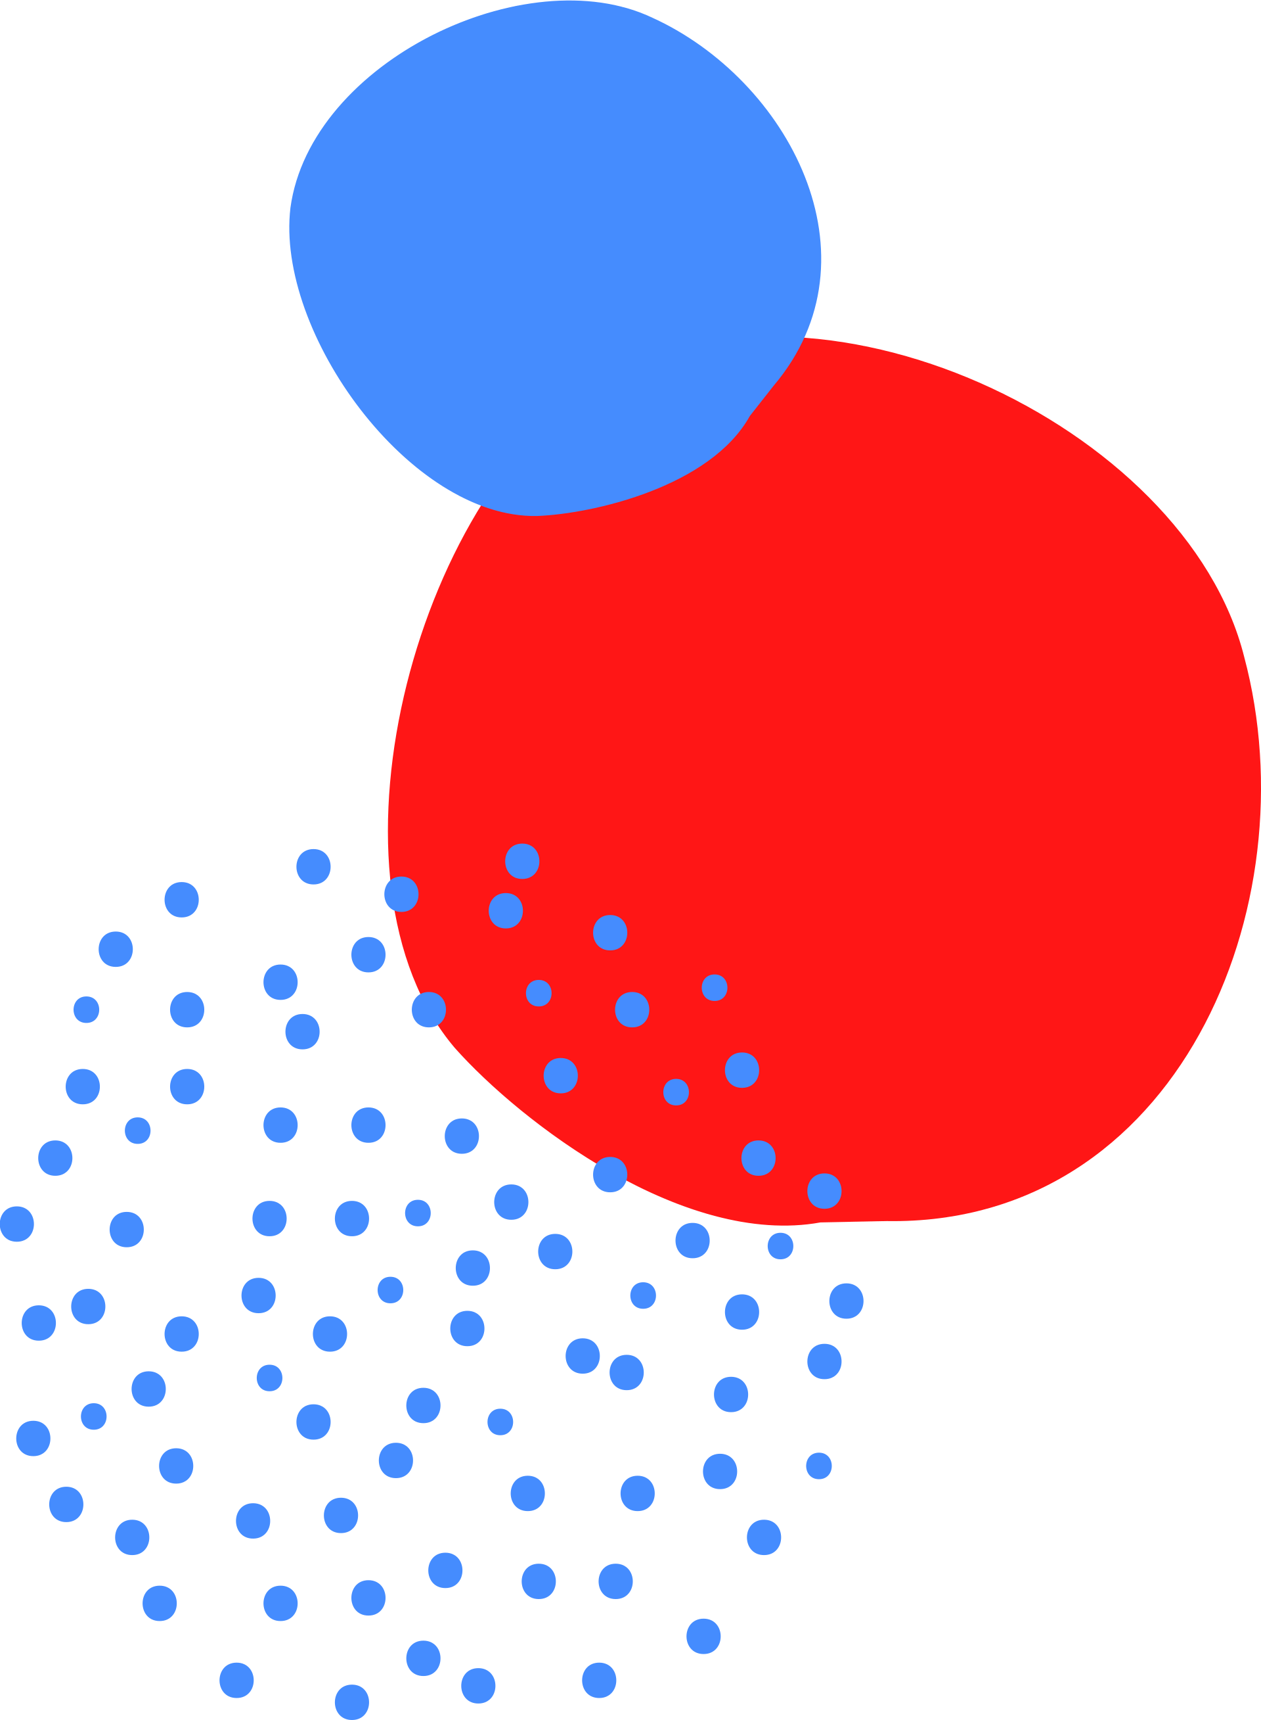

What are databases ?

Slide 3
A database is an organized collection of structured information, or data, typically stored electronically in a computer system. A database is usually controlled by a database management system (DBMS). Together, the data and the DBMS, along with the applications that are associated with them, are referred to as a database system, often shortened to just database.

Slide 4

What is Firebase ?

Slide 5
SQL and NoSQL Databases

Slide 6
SQL
SQL is a programming language used by nearly all relational databases to query, manipulate, and define data, and to provide access control.
Popular DBMS: MySQL, PostgreSQL, Oracle, SQLite

Slide 7
SQL
How does it work?
Relations, Attributes, Relationship

Slide 8
SQL
Employee
ID | Name | Gender | Salary | Email
Works On
Employee
Project

Slide 9
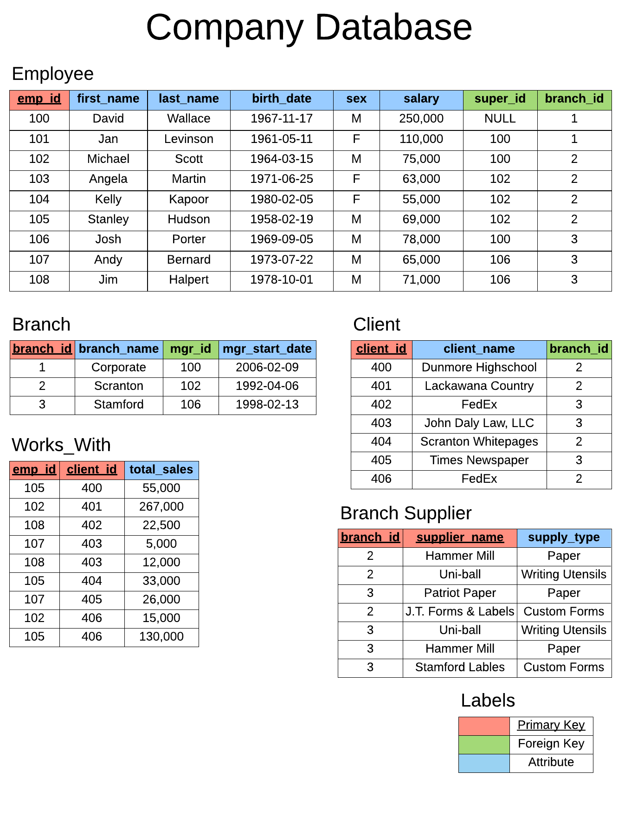

Slide 10
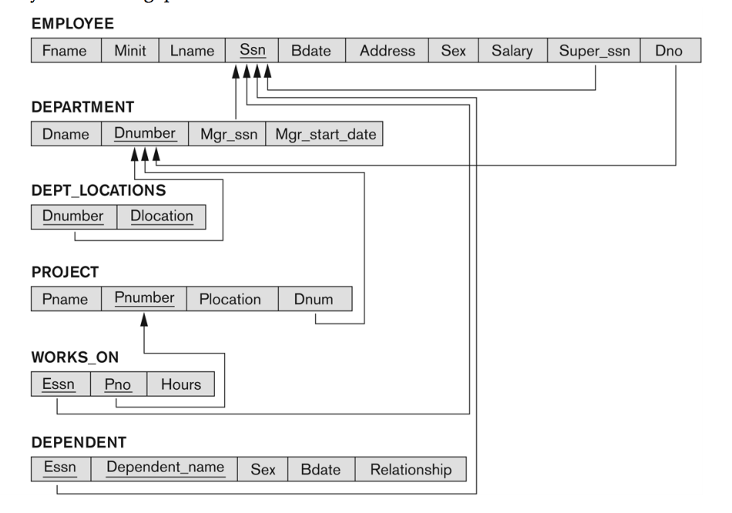
Relationships
One – to – One
One – to – Many
Many – to - Many

Slide 11
NoSQL
NoSQL databases (aka "not only SQL") are non tabular, and store data differently than relational tables. NoSQL databases come in a variety of types based on their data model.
The main types are document, key-value, wide-column, and graph. They provide flexible schemas and scale easily with large amounts of data and high user loads.

Slide 12
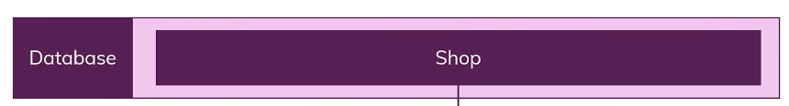


NoSQL
How does it work?

Slide 13
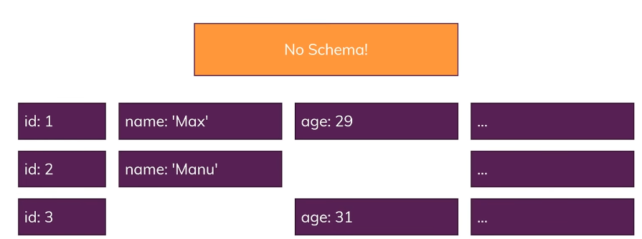
NoSQL
No Schema
No Tables
No Relationships

Slide 14
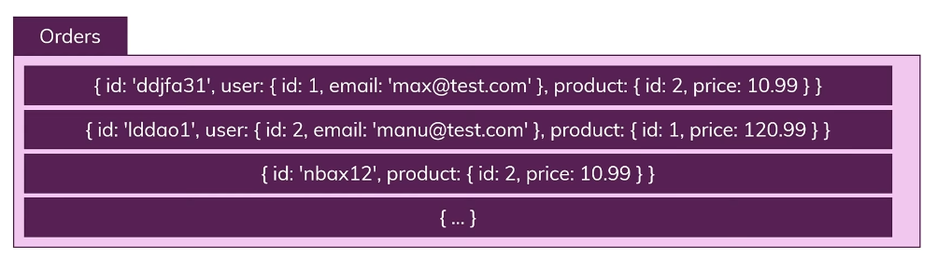
NoSQL
No Merging!
Way super fast

Slide 15
Which One should we use ?
It depends

Slide 16


We're done!
Thank you for participating. Have a great day ahead.

